Slide 1
Using SVM to predict fake news and real news
Team Menber :
Yi Tian
Xiaolin Yang
Kai Li

Slide 2
Why Fake News Is A Problem?
Fake news refers to misinformation, disinformation or mal-information which is spread through word of mouth and traditional media and more recently through digital forms of communication such as edited videos, memes, unverified advertisements and social media propagated rumors. Fake news spread through social media has become a serious problem, with the potential of it resulting in mob violence, suicides etc. as a result of misinformation circulated on social media.

Slide 3
Brief Description Of Dataset
This dataset consists of about 40000 articles consisting of fake as well as real news. Our aim is train our model so that it can correctly predict whether a given piece of news is real or fake. The fake and real news data is given in two separate datasets with each dataset consisting around 20000 articles each.

Slide 4
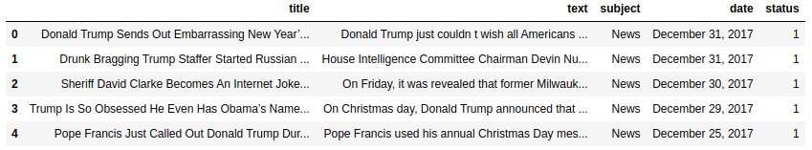
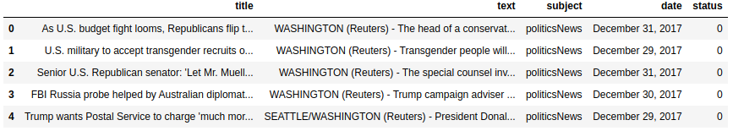
Dataset
Part of Real News Dataset
Part of Real Fake Dataset

Slide 5
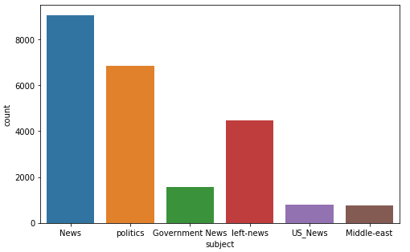
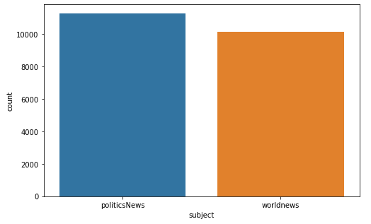
Dataset
Subject Of News In Dataset

Slide 6
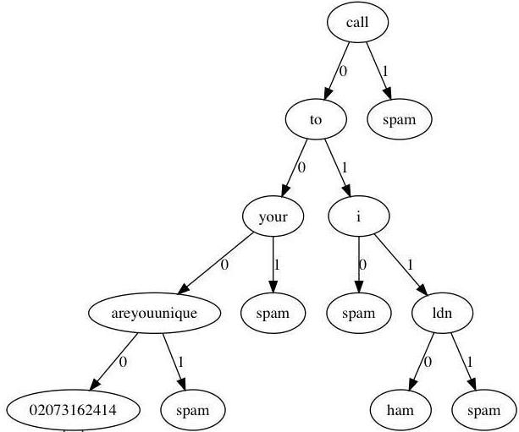
Naive Bayes Classifier
Naive Bayes classifier is a series of simple probabilistic classifiers based on the assumption of strong (plain) independence between features using Bayes' theorem. The classifier model assigns class labels represented by eigenvalues ​​to problem instances, and the class labels are taken from a finite set. It is not a single algorithm for training this classifier, but a series of algorithms based on the same principle: all naive Bayes classifiers assume that each feature of the sample is not related to other features.

Slide 7
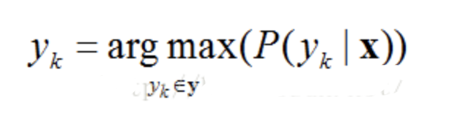
The implement of Naive Bayes
Bayesian decision theory refers to a decision theory which is informed by Bayesian probability. It is a statistical system that tries to quantify the tradeoff between various decisions, making use of probabilities and costs. An agent operating under such a decision theory uses the concepts of Bayesian statistics to estimate the expected value of its actions, and update its expectations based on new information.
Let’s take an example.
For D dimensions object x=(x₁, x₂,...x_{D}) with K classifications y=(y₁,y₂,...y_{K}), we can get
y_{k} is classification k. The probability that x belong to y_{k} is P(y_{k}|x).

Slide 8
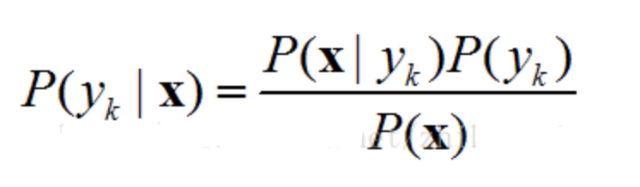
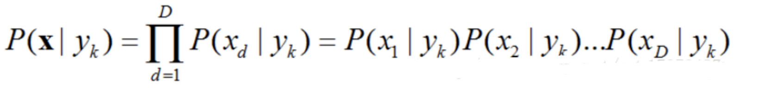
The implement of Naive Bayes
We can calculate P(y_{k}|x) by Bayesian Formulation and then get
In this formulation, P_{(x)} is constant, and P(y₁)=P(y₂)=...=P(y_{K}). So, to find the maximum of P(y_{k}|x), we have to find the maximum of P(x|y_{k}).
Because the attributes of data object X are independent of each other,

Slide 9
Support Vector Machine
Support-vector machines (SVM) are supervised learning models with associated learning algorithms that analyze data used for classification and regression analysis. Given a set of training examples, each marked as belonging to one or the other of two categories, an SVM training algorithm builds a model that assigns new examples to one category or the other, making it a non-probabilistic binary linear classifier. A SVM model is a representation of the examples as points in space, mapped so that the examples of the separate categories are divided by a clear gap that is as wide as possible. New examples are then mapped into that same space and predicted to belong to a category based on the side of the gap on which they fall.
More formally, a support-vector machine constructs a hyperplane or set of hyperplanes in a high- or infinite-dimensional space, which can be used for classification, regression, or other tasks like outliers detection. Intuitively, a good separation is achieved by the hyperplane that has the largest distance to the nearest training-data point of any class (so-called functional margin), since in general the larger the margin, the lower the generalization error of the classifier.

Slide 10
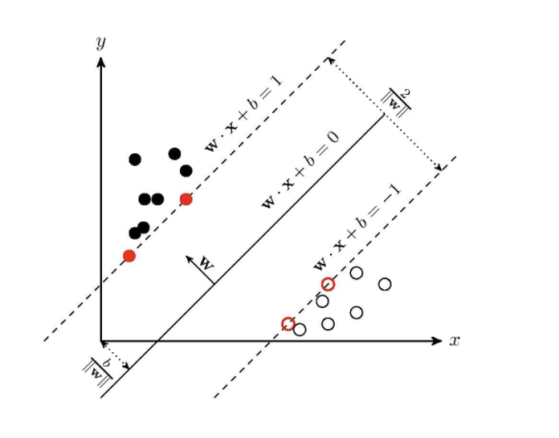

Support Vector Machine
The aim for SVM is to get the maximum-margin hyperplane and maximum-margin classifier.
Hyperplane:

Slide 11
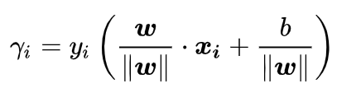




Support Vector Machine
For a given data set T = {(x1,y1),(x2,y2)…(xN,yN)}, the geometric spacing is
So, a problem of SVM can be transform to a optimal solution problem.
This problem can be further simplified as

Slide 12
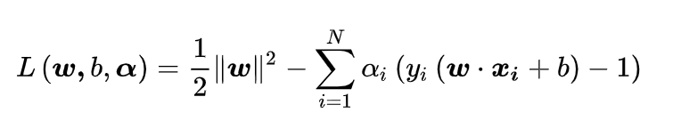
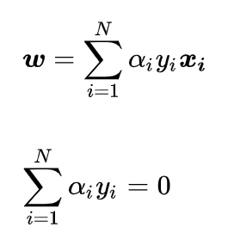
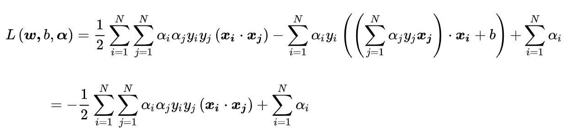
Support Vector Machine
Lagrange:
Get partial derivative of ω and b.
Put them into Lagrange formulation above

Slide 13
Support Vector Machine

Slide 14
Support Vector Machine

Slide 15
Support Vector Machine

Slide 16
Kernel Method
In machine learning, kernel methods are a class of algorithms for pattern analysis. The general task of pattern analysis is to find and study general types of relations in datasets. For many algorithms that solve these tasks, the data in raw representation have to be explicitly transformed into feature vector representations via a user-specified feature map: in contrast, kernel methods require only a user-specified kernel, i.e., a similarity function over pairs of data points in raw representation.
Most kernel algorithms are based on convex optimization or eigenproblems and are statistically well-founded. Typically, their statistical properties are analyzed using statistical learning theory.

